Slide 1
Seasons & Shootings
Relationships between Season and Shooting Incidents in New York City 2006 - 2020

Slide 2
Introductions
Clay Ver Valen
Masters Program for Data Science - University of Colorado Boulder
Technical Leader at Cisco Systems
Previously at Microsoft, Yahoo!, and several start-ups

Slide 3
Data Source
NYPD Shooting Incident Data (Historic)
https://data.cityofnewyork.us
Covers incidents from 2006 through the end of 2020
Each record represents a shooting incident in NYC
Data set includes for each incident
Date and time
Location (borough, precinct, mid-block latitude and longitude)
Demographic information on both victim and perpetrator (age group, race, gender)
Whether shooting victim died making it count as a murder

Slide 4
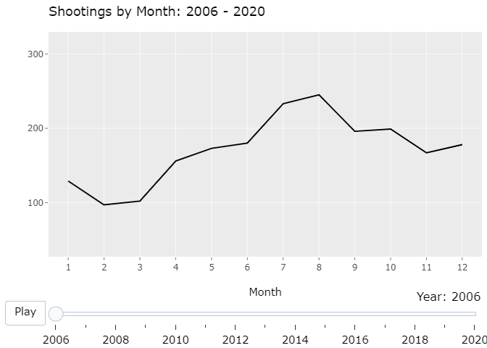
Shootings by Month

Slide 5
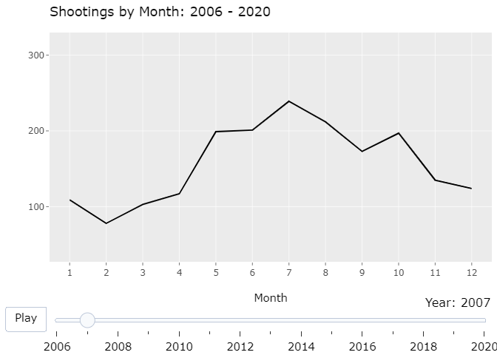
Shootings by Month

Slide 6
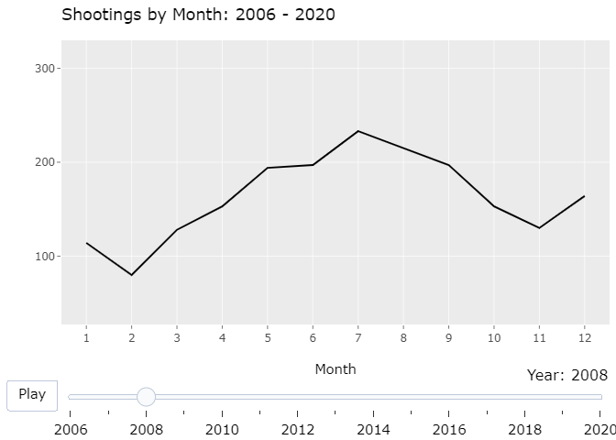
Shootings by Month

Slide 7
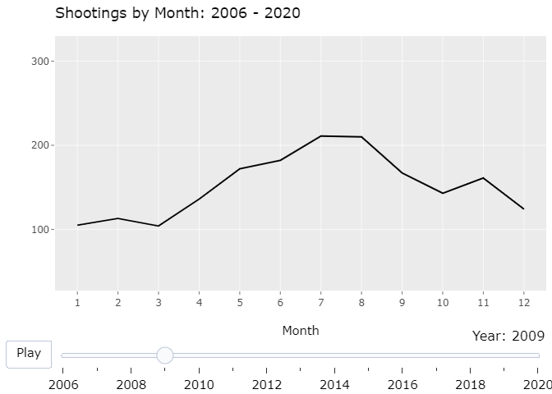
Shootings by Month

Slide 8
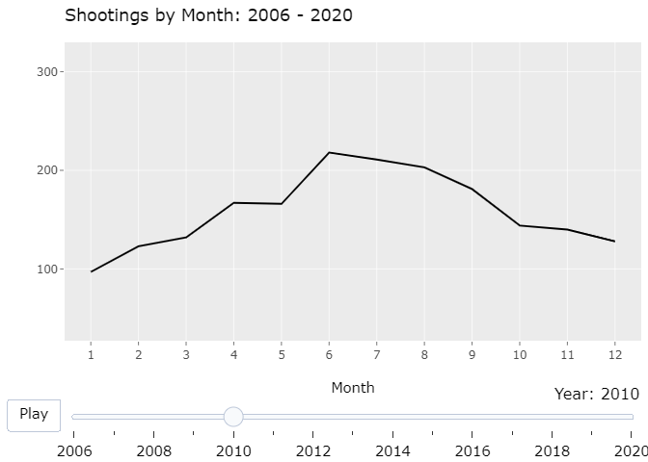
Shootings by Month

Slide 9
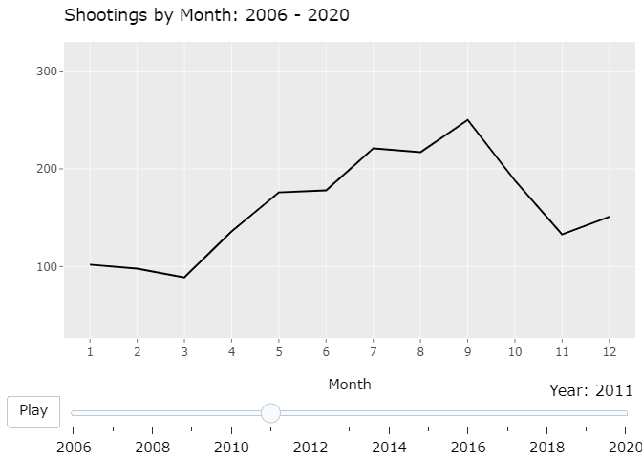
Shootings by Month

Slide 10
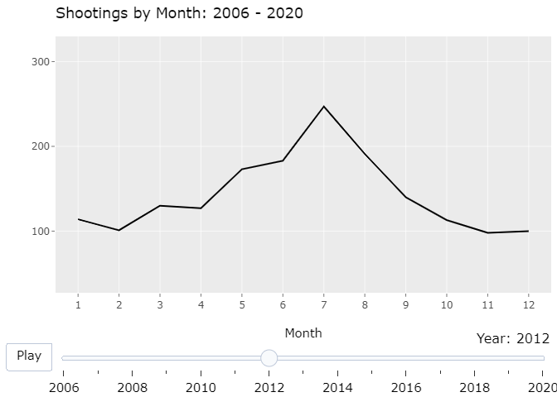
Shootings by Month

Slide 11
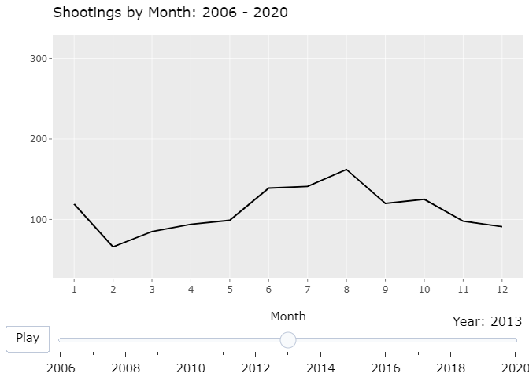
Shootings by Month

Slide 12
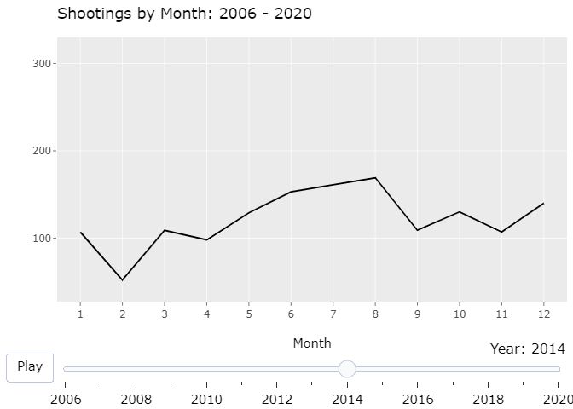
Shootings by Month

Slide 13
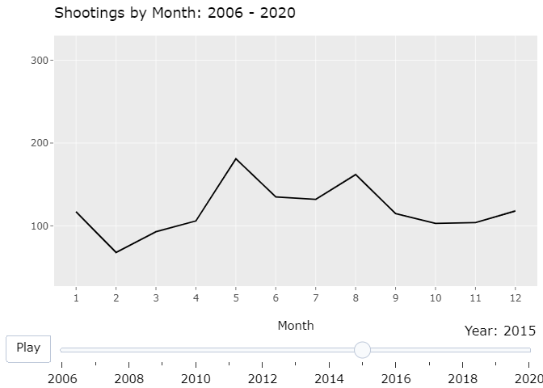
Shootings by Month

Slide 14
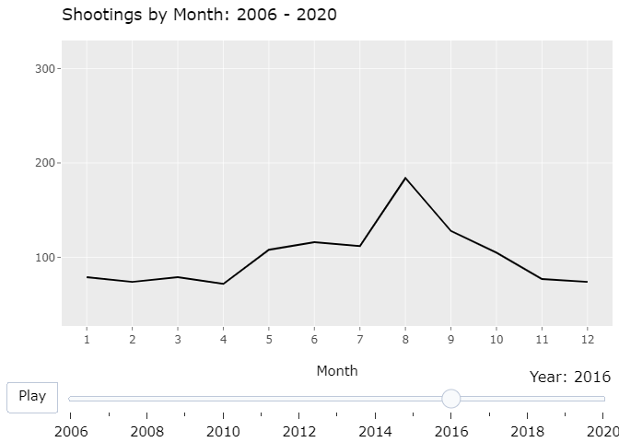
Shootings by Month

Slide 15
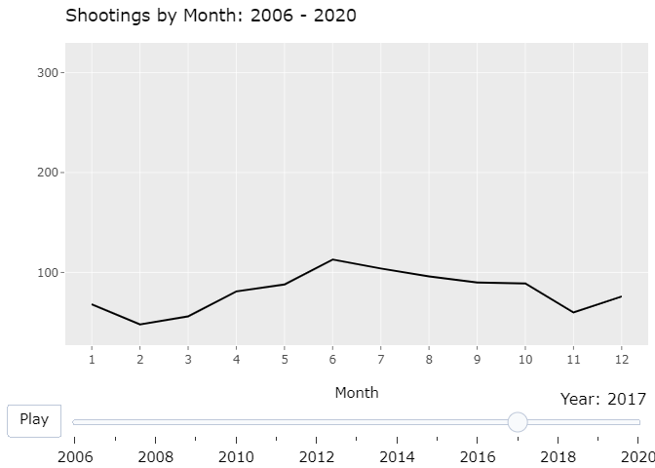
Shootings by Month

Slide 16
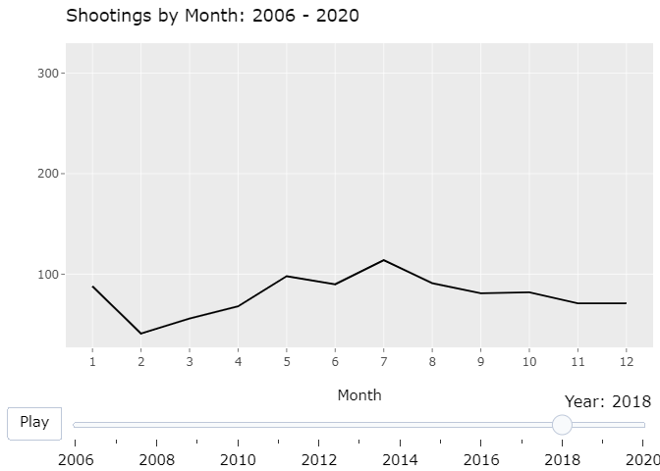
Shootings by Month

Slide 17
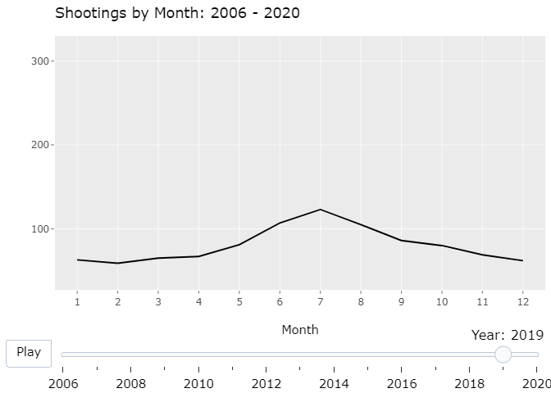
Shootings by Month

Slide 18
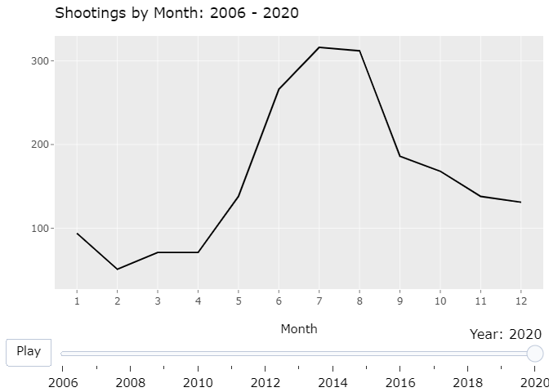
Shootings by Month

Slide 19
New York City Gun Laws
Some of the strictest in the United States
Requires a license
License application requires 2 photos, proof of residence, Social Security card, and New York State driver’s license
Other documents are often asked for, such as a New York State income tax return or a current utilities bill
If ever arrested must supply paperwork pertinent to it even if the charges were dismissed
5 different kinds of licenses each with different privileges

Slide 20
Where do shootings happen most?
Borough | Shootings since 2010
Brooklyn | 6,484
Bronx | 4,551
Queens | 2,389
Manhattan | 1,945
Staten Island | 471

Slide 21
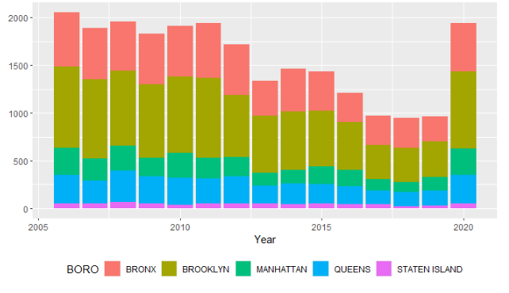
Shootings By Year And Borough

Slide 22
Conclusion
Avoid Bronx and Brooklyn in the summer months

Slide 23
Sources of Bias
Does not take into account population in the boroughs
Does not take into account socio-economic factors
Does not take actual temperatures into account

Slide 24
Reproducible Report Location
https://github.com/clayv/UC_Boulder_DTSA5301_Final/tree/main/NYPD_Shootings
Contains
RStudio Rmd
Knitted HTML
Powerpoint slide deck

Slide 25
Thank You!

